Slide 1
PM-ScaleCases: Scalable Prediction Market Use Cases

Slide 2
Three Projects
InvestorX
Provides financial advices for Ethereum investors
SurveyX
Crowd opinion mining and rewarding
NonRepudiationX
(NRX)
A BlockChain scalability solution as part of Gnosis Apollo

Slide 3

InvestorX
Provides financial advices for Ethereum investors.

Slide 4
InvestorX
A prediction market use-case that aims to provide the best financial advices for investors on Ethereum platform.
Users nominate and vote for the wallet that contains the best combination of Ethereum Tokens.
The PM question will be: Which wallet has the best ROI for a specific period?

Slide 5
InvestorX – POC
A POC is currently deployed on Rinkeby Testnet and available at http://investorx.io
It is built with Angular, Truffle 5 & and Solidity 0.5. The code is available at https://github.com/apper-tech/investorX
It will be reimplemented with Gnosis Apollo and NonRedpudationX.

Slide 6
InvestorX – POC
Current smart contracts handle:
Receiving Gurus' applications (names and wallets)
Accepting votes from Followers
Running (starting & closing) the election by Chairperson

Slide 7
InvestorX POC Screenshots

Slide 8
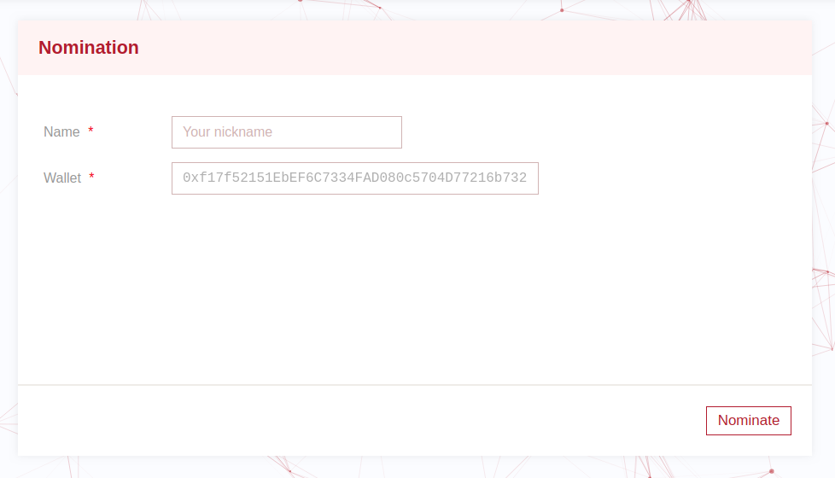
InvestorX – Nomination Page
Any user can nominate him/herself

Slide 9
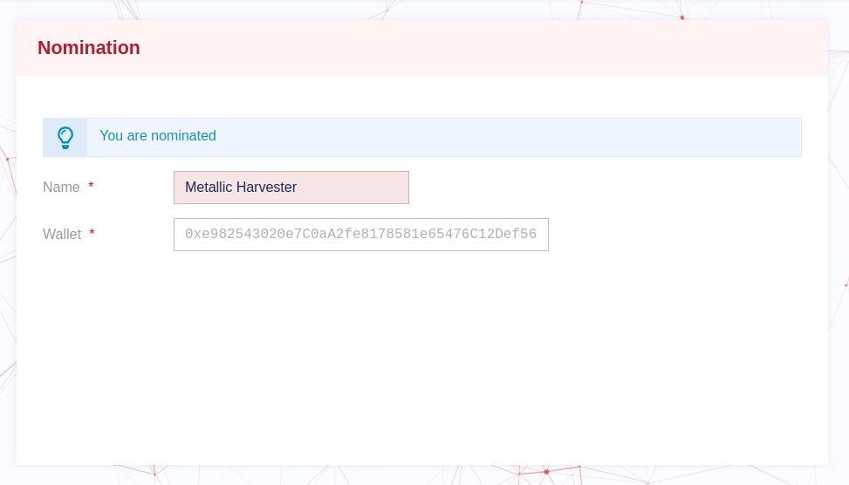
InvestorX – Nomination Page
The page after the user nominate himself/herself.

Slide 10
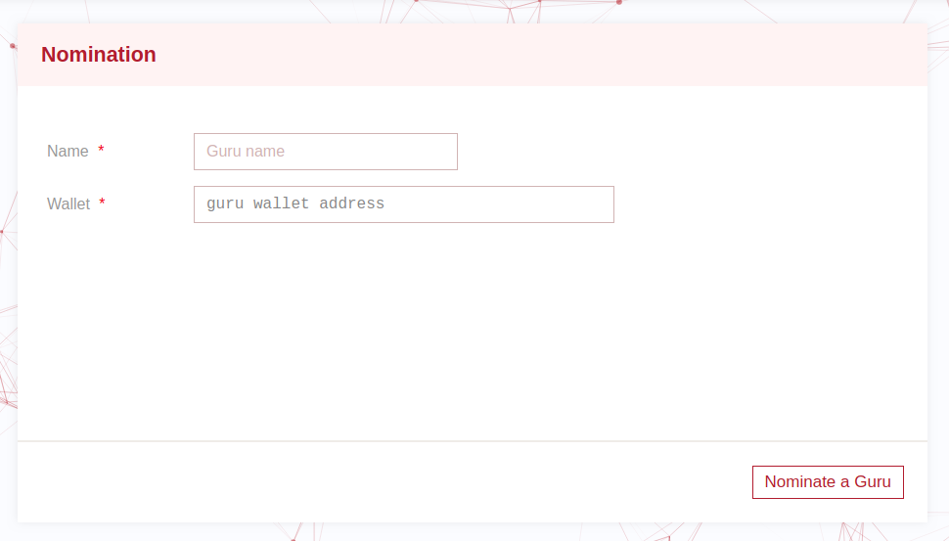
InvestorX – Nomination Page opened by Chairperson
The page react differently to the chairperson

Slide 11
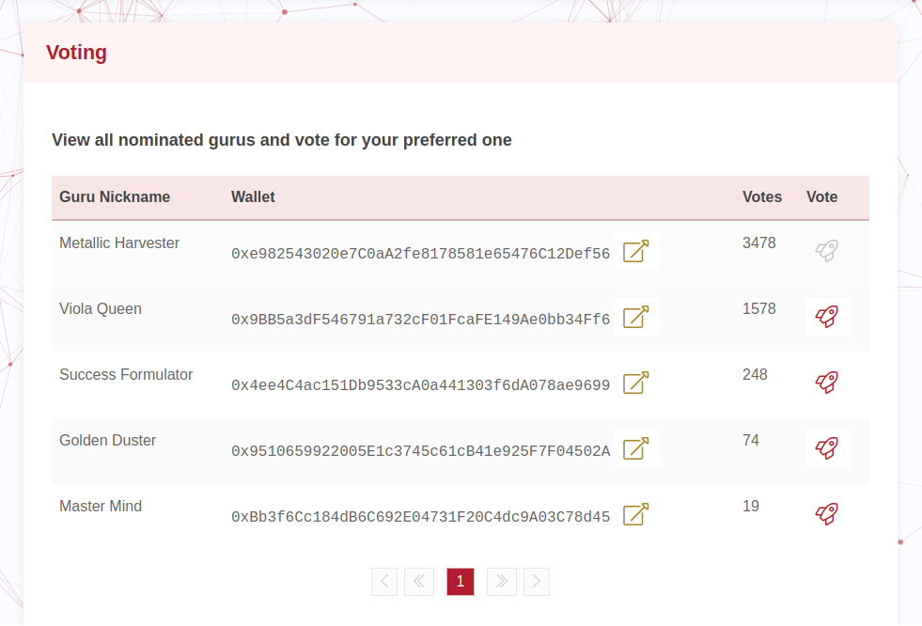
InvestorX – Voting Page

Slide 12

SurveyX
Crowd opinion mining and rewarding

Slide 13
SurveyX
Facilitates crowd opinion mining and incentivization for any survey that is made for any purpose.
It is not a prediction market use-case. But, it is a nice example of how some projects could be modeled and built as a prediction market with Gnosis Apollo.

Slide 14
SurveyX – POC
A POC is currently deployed on Rinkeby Testnet and available at http://surveyx.io
It is built with React, Truffle 5 and solidity 0.5. The code is available at https://github.com/apper-tech/surveyx
It will be reimplemented with Gnosis Apollo and NonRedpudationX.

Slide 15
SurveyX – POC
In this POC a user can:
Surveyor
Create a survey
Share the survey with Participants
End a survey
Participants
Participate in a survey

Slide 16
SurveyX POC Screenshots

Slide 17
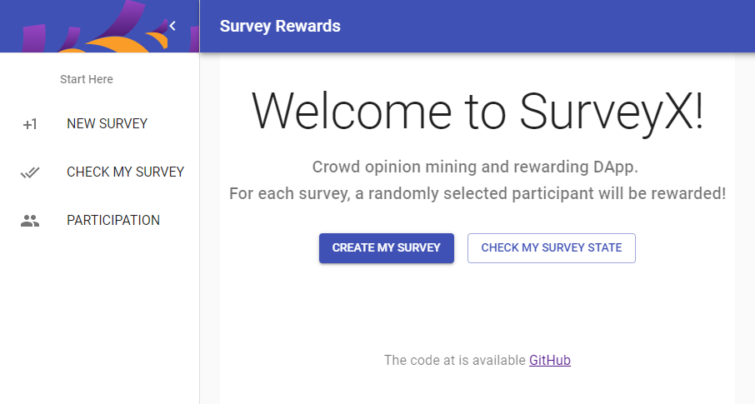
SurveyX – Landing Page
The page after the user nominate himself/herself.

Slide 18
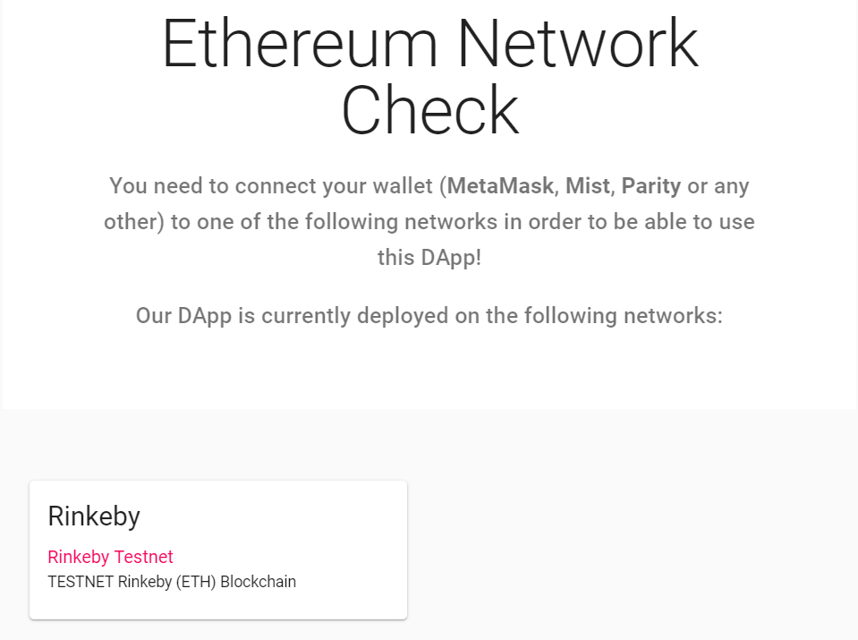
SurveyX – Connectivity Page

Slide 19
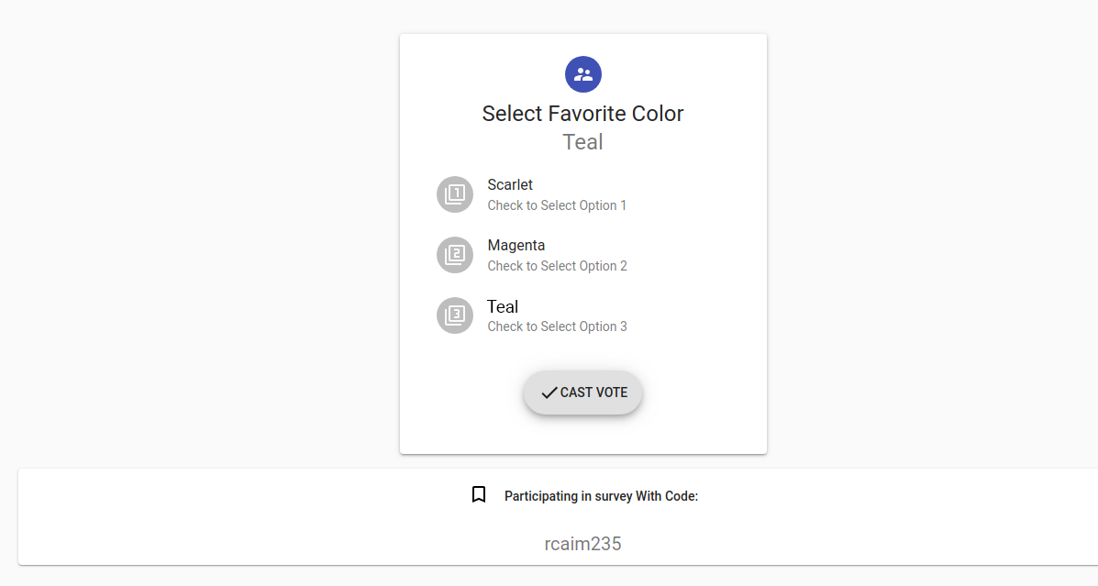
SurveyX – Participation Page

Slide 20
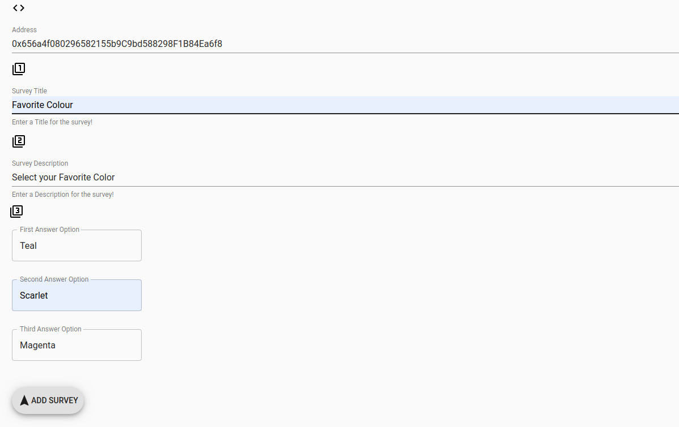
SurveyX – Survey Creation Page

Slide 21
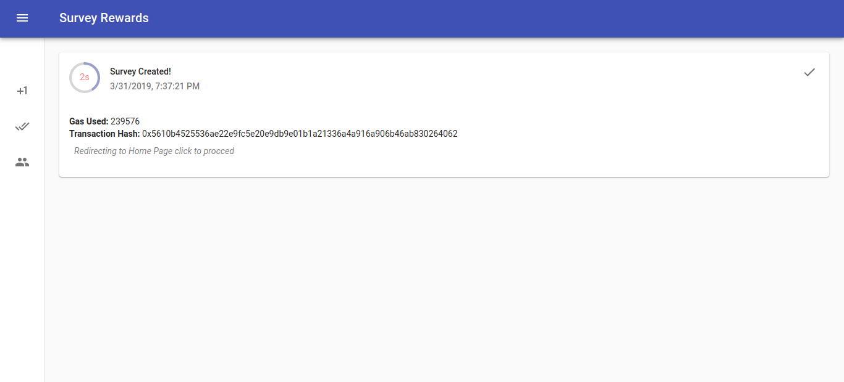
SurveyX – Survey Created Page

Slide 22
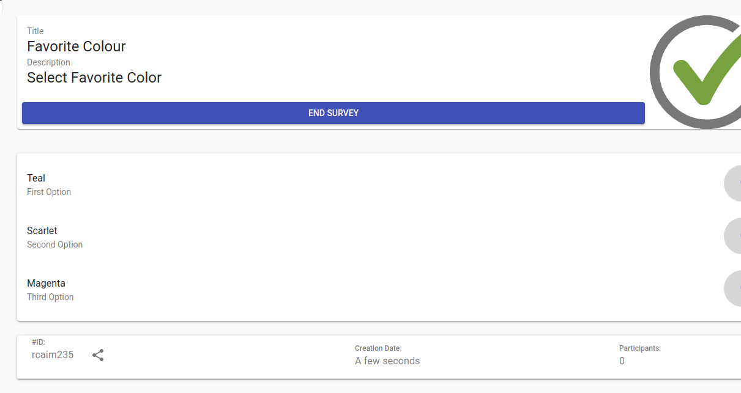
SurveyX – Survey Management Page

Slide 23
NonRepudiationX
A BlockChain scalability solution as part of Gnosis Apollo
NRX

Slide 24
NonRepudiationX – Why?
BlockChain till now did not reach mass-adoption.
Two of the main reasons for that are the scalability (limited number of transactions per second) and the cost (transaction cost is relatively high).
Ethereum storage exceeded 1 TB. This is an alert for the community that should encourage a wise storage usage.

Slide 25
NonRepudiationX – What?
NRX depends on using off-chain non-repudiation communication, that could be claimed on-chain.
It is BlockChain scalability solution that best fit for prediction markets and can leverage Gnosis Apollo and expose it to more use-cases.
It increases the speed in addition to lowering the cost paid by the end user.

Slide 26
NonRepudiationX – Results
It will Enable the users to vote, participate in surveys and do any other prediction market participation activities for free.
And the users will only pay for the transaction when they will claim their rewards (if there is any).
It causes less transactions to be saved on Ethereum that exceeded 1 TB.

Slide 27
Sequence Diagram
NRX

Slide 28
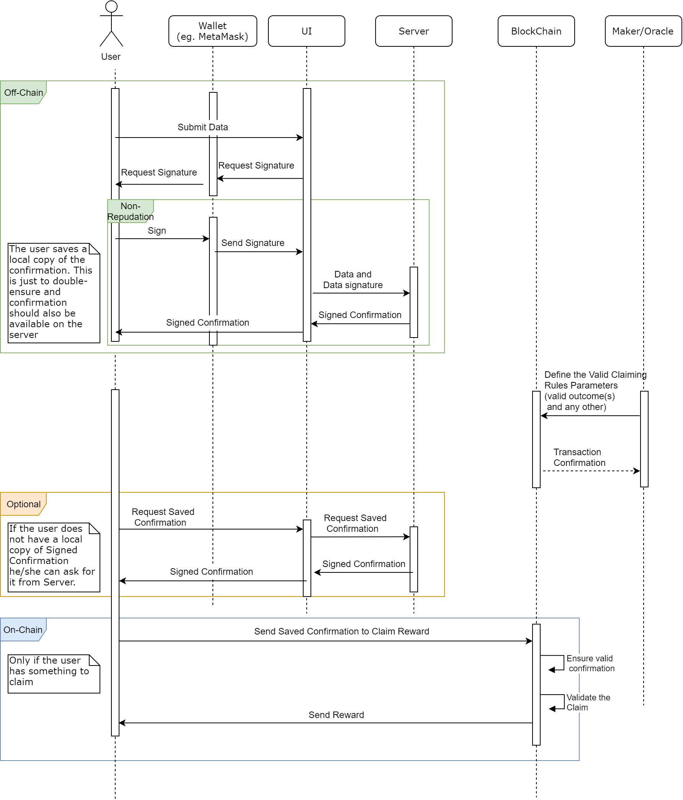

Slide 29
NonRepudiationX - How
The off-chain signature will be done in compliance of the EIP712 standard that is already implemented in MetaMask.
Solidity have `ecrecover` function that can be used for on-chain verification. (OpenZeppelin provided a standard hash-verification library: https://docs.openzeppelin.org/docs/cryptography_ecdsa)

Slide 30
NonRepudiationX - Conclusion
We think that InvestorX and SurveyX, like almost all other use-cases that could be built with Gnosis Apollo, will stay under the hood, if they were not provided with a scalability solution.
And we believe that NonRepudiationX is fairly simple, yet powerful enough, and best fit for a prediction market. And it can attract developers and end-users to use Gnosis Apollo and the solutions built with

Slide 31
Core Team
Muhammad Altabba - CEO
Full Stack BlockChain Developer with solid and extensive commercial experience in Web Application development.
LinkedIn: https://www.linkedin.com/in/muhammadaltabba/
Stack Overflow: https://stackoverflow.com/users/8303489
Ethereum Stack Exchange: https://ethereum.stackexchange.com/users/23253
GitHub: https://github.com/Muhammad-Altabba
BlockChain Articles: https://medium.com/@maltabba

Slide 32
Core Team
Muhammed Mazen Hafez - Full-Stack Developer
Full-stack web and blockchain developer. He is faster learner and he has been working on this field since 2015 on various web platforms.
LinkedIn: https://www.linkedin.com/in/mhmazen/
GitHub: https://github.com/mh-mazen

Slide 33
Core Team
Qamar Alzaman Hafez - System Analyst
Has BCS in Information Technology engineering, specialized in AI.
Skilled in Software Design, Maintenance, Development Process and Architecture.
LinkedIn: https://www.linkedin.com/in/qamaral-zamanhafez/
GitHub: https://github.com/Nayoshca

Slide 34
Milestones & Deliverables
The work will span on 1 year divided into 3 phases
Asking Gnosis for a grant of
90 000 USD

Slide 35
Milestones, and Deliverables Phase I - Core Features
Deliverables
Rebuild InvestorX and SurveyX with Gnosis Apollo
InvestorX beta version
SurveyX beta version
Create Truffle for InvestorX and SurveyX
Implement NonRepudiationX and use it with InvestorX and SurveyX.
Time Estimate: 4 months
Notes:
Create Truffle Boxes (https://truffleframework.com/boxes)
Truffle Box for InvestorX as a fully featured sample starting Angular project built with Gnosis Apollo.
Truffle Box for SurveyX as a fully featured sample starting React project built with Gnosis Apollo.
Creating Truffle boxes means clear and clean code that fit for the purpose, but also generalized for other cases.

Slide 36
Phase II – Enhancements, Stabilization and Code Refactoring
Deliverables
Heavy testing and bugs fixes.
Deploy to Ethereum main net.
Integrate NRX with Gnosis Apollo packages
Implement additional app-specific features like reports, a dashboard and etc...
Design and implement a business model for InvestorX and SurveyX.
Time Estimate: 4 months
Notes:
Integrate NRX with Gnosis Apollo packages (we will fork the repositories and make pull-requests for Gnosis repositories: pm-contracts, pm-js, pm-trading-db and pm-trading-ui).

Slide 37
Phase III
Final Technical Touches, Community Building, and Business Model Fine-Tuning
This phase is where we will look more for achievements from a business point of view.
This is only doable having a solid and sound solution.
How much effect we could make, is a proof of a good technical solution in addition to hard and smart work.

Slide 38
Phase III – Deliverables 1/3
The deliverables are to ensure a successful achievement to at least 5 of the following numbers:
20 enhancements or feature-requests implemented for opened issues at github.com
2000 users on InvestorX.io and SurveyX.io together (this ensures a good business model in addition to a good technical solution).

Slide 39
Phase III – Deliverables 1/3
2000 viewers for 2 or more Medium articles on how to use Gnosis and Gnosis Apollo (starting from our Truffle Boxes).
2000 viewers for YouTube marketing video(s).
2000 viewers for YouTube video(s) in which we will explain about Gnosis, Gnosis Apollo, including our Truffle Boxes and how to use NonRepudiationX.

Slide 40
Phase III – Deliverables 1/3
One or more published research paper (most likely about NonRepudationX) in an academic journal or conference.
2 partnerships with other projects.

Slide 41
Thanks!
Questions!

